Slide 1
Starting from Scratch
How to Sponsor New Clubs
218HCD

Slide 2
Introduction
Enhance your leadership skills.
Develop project-management abilities.
Expand your marketing expertise.

Slide 3
Session Topics
A sponsor’s duties.
Establish a corporate club.
Launch a community club.
Feed their enthusiasm.
Complete the charter.
Plan the presentation.

Slide 4
A Sponsor’s Duties
Organize the new club.
Set up regular club meetings.
Complete the paperwork and plan the charter presentation.

Slide 5
Types of Clubs
Corporate
Community
Advanced
Specialty

Slide 6
Establish a Corporate Club
The New Club Information Kit
How to Build a Toastmasters Club
Forms
Promotional brochures

Slide 7
Establish a Corporate Club
Toastmasters Teamwork
Two sponsors
Two mentors
The District Director
The Club Growth Director
Other Toastmasters and District leaders

Slide 8
Establish a Corporate Club
Identify Your Target
Company
Size
Location
Revenue
Key contacts and decision-makers
Company
Strategies
Key initiatives
Priorities
Focus and mission
Recent news articles

Slide 9

Establish a Corporate Club
Introduce Yourself.

Slide 10
Establish a Corporate Club
After the Introduction
Set an appointment.
Prepare for the meeting.
Share about other corporations.
Wrap it up.

Slide 11
Establish a Corporate Club
Discussing the Finances
Finalize its financial commitment.
Determine what portion of the club costs the company will pay.

Slide 12
Establish a Corporate Club
Money Matters
Designate a club officer to hold the payments.
Hold the payments until they are sent to Toastmasters International.
Deposit the payment into another club’s account.

Slide 13
Establish a Corporate Club
Demonstration Meetings
Toastmaster
Timer
Ah-Counter
Grammarian
General Evaluator
Speaker
Evaluator
Topicsmaster

Slide 14
Establish a Corporate Club
The Demonstration Meeting
Keep the meeting within time limits.
Include three aspects.
Select a team.
Select Toastmasters for various roles.
Invite high-level representatives.
Have each guest sign a guest book.

Slide 15
Establish a Corporate Club
Before the Demonstration
Appoint prospective members.
Ask for volunteers.
Volunteers need not speak.
During the Demonstration
Prospective member comes to lectern when called.
Toastmaster acts as the narrator.
Toastmaster describes the role.

Slide 16
Launch a Community Club
Toastmasters Teamwork
Two sponsors
Two mentors
District Director
Club Growth Director
Other Toastmasters and District leaders

Slide 17
After the Demonstration
Introduce the sponsors and mentors.
Question-and-answer.
Toastmasters share success stories.
Complete Application to Organize.
Submit Application to Organize and charter fee.

Slide 18
Launch a Community Club
Steps to Chartering
Plan a demonstration meeting.
Publicize the meeting.
Contact the local chamber of commerce.
Display posters and announcements.
Target specialized groups.

Slide 19
Feed Their Enthusiasm
Steps to Chartering
Announce the next meeting.
Select temporary officers.
Follow up with reminder notices.
Collect dues.
Pay the charter fee.
Conclude with recognition.

Slide 20
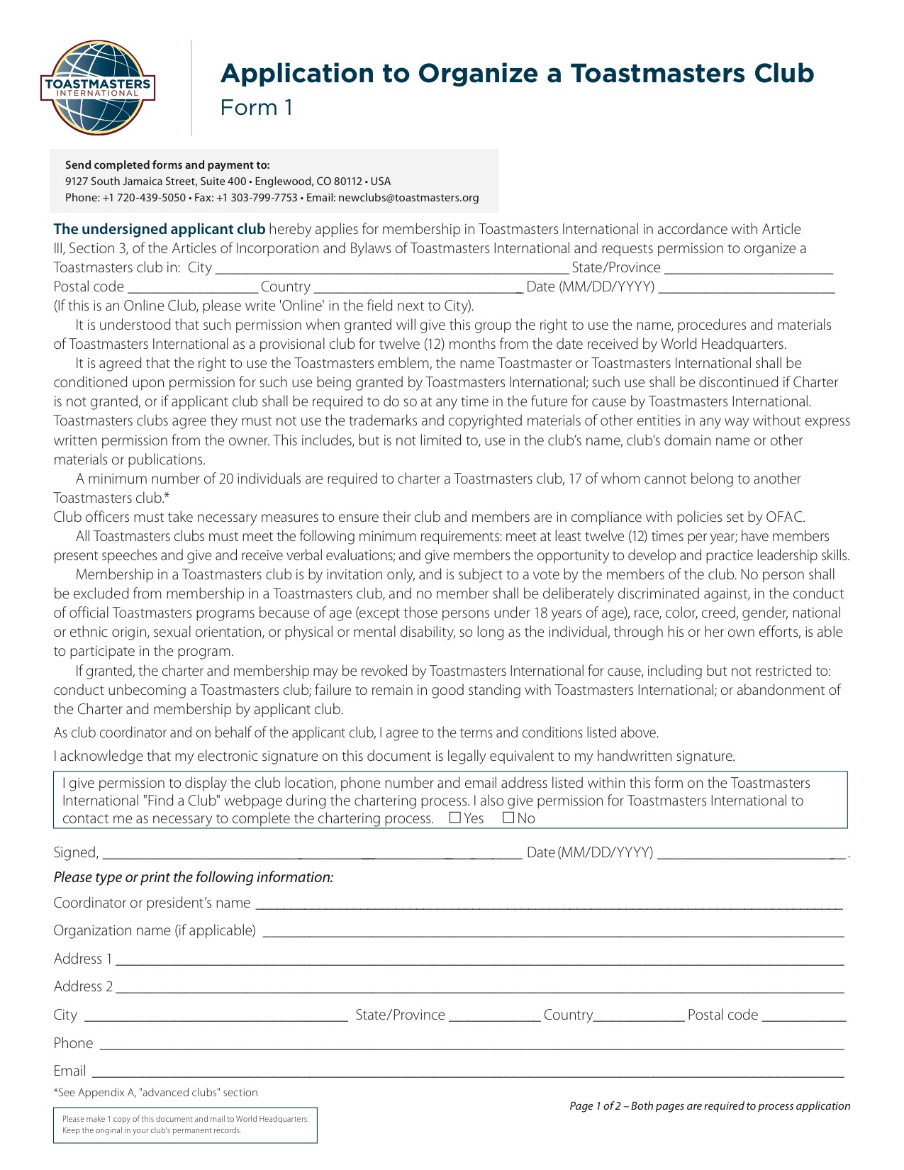
Complete the Charter
www.toastmasters.org/121

Slide 21
Plan the Presentation
Invite the guests.
Plan the meal.
Publicize the charter presentation.
Form committees.
Prepare a printed program.
Include a short meeting.

Slide 22

Closing

